Slide 1
Control Systems Research in the Autonomous Flight Systems Laboratory
Christopher Lum
Juris Vagners

Slide 2
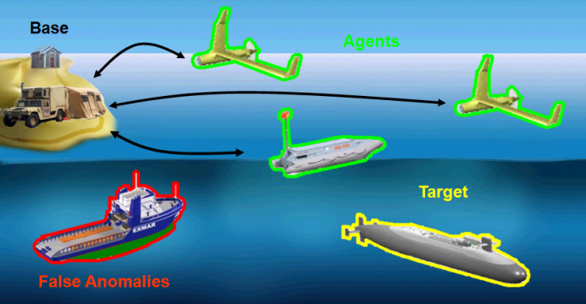
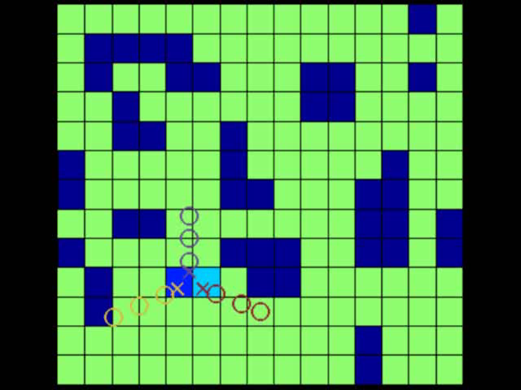
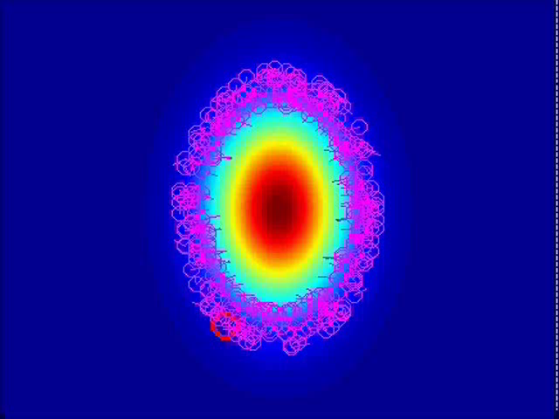
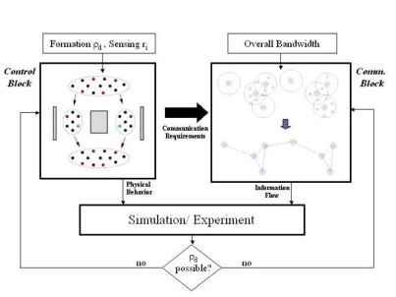
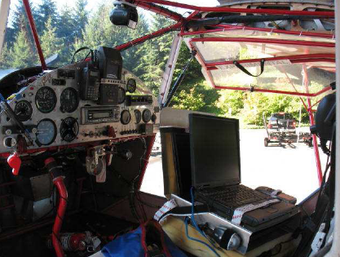
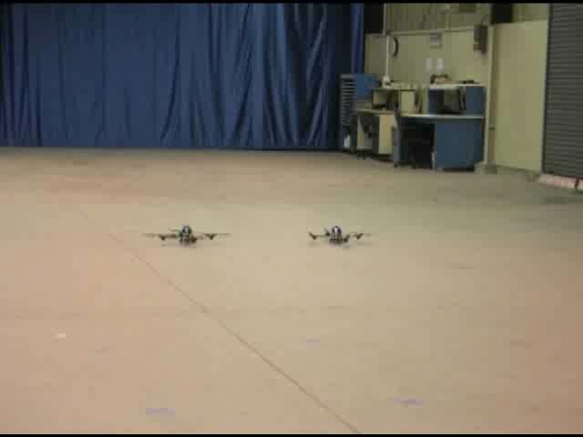
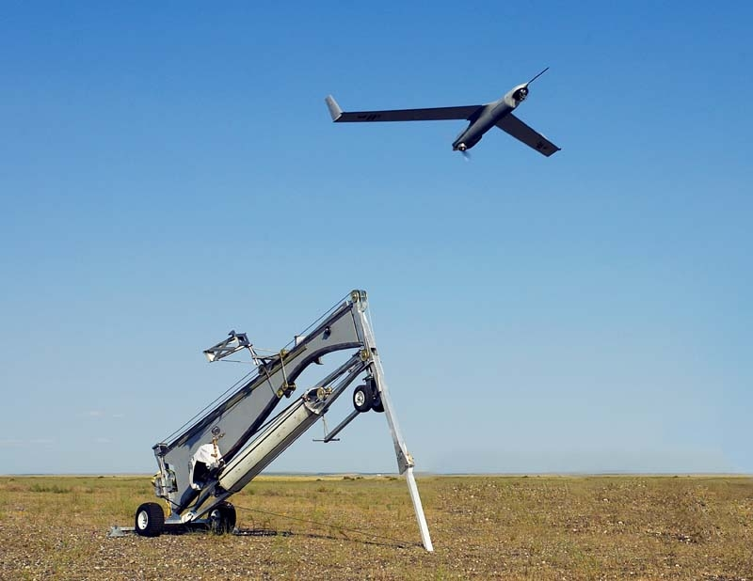
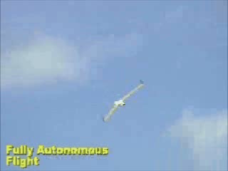
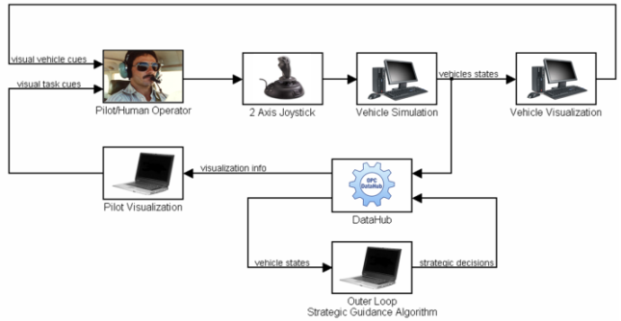
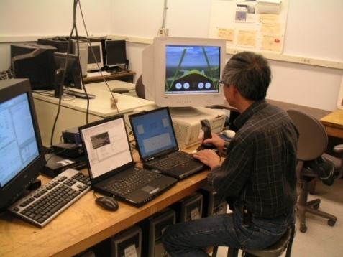
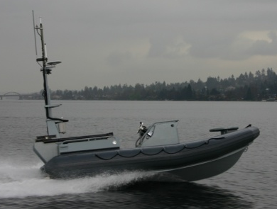
Autonomous Flight Systems Laboratory
Dynamic Mission Management
The mission of the AFSL is to conduct research that advances technologies relevant to unmanned systems
Algorithm Development
Flight Testing and Integration
General UAS GN&C Work
Human in the Loop Architectures
Notes:
Juris and I run the Autonomous Flight Systems Laboratory in the William E. Boeing Department of Aeronautics and Astronautics at the University of Washington. The mission of our lab is to conduct research that advances technologies that are relevant to unmanned systems.
Historically, the majority of our research has been directed towards control algorithm development but we are also interested in flight testing and integration, human-in-the-loop operations, and autonomous technology development in general.
One thing that makes our group unique is the fact that in addition to pure basic research, our group is very interested in transitioning technologies out of an academic environment and onto fielded systems. To this end, we’ve partnered with local, Washington industry such as Boeing, Aerovel, and Insitu in the past.

Slide 3
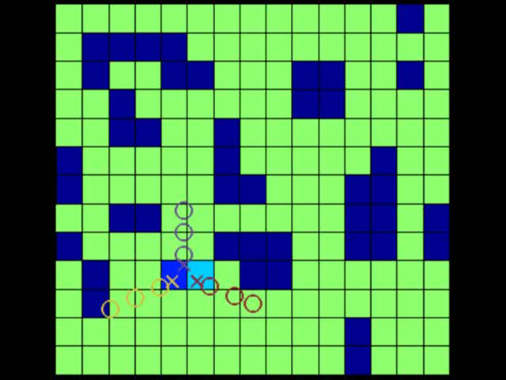
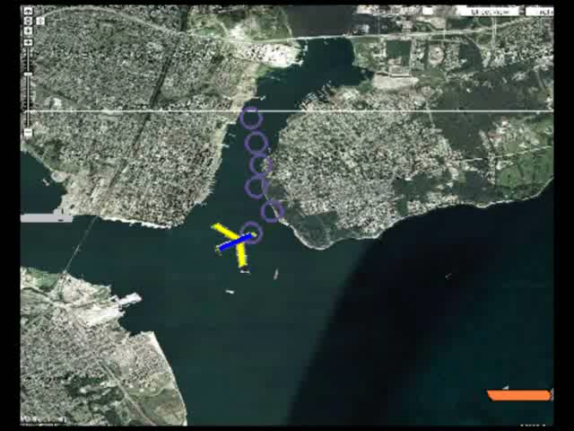
Coordinated Search
Algorithms to coordinate a group of vehicles in a search mission.
Applications to search and rescue, persistent surveillance, etc.
3 vehicles exhaustively searching map
Persistent surveillance in a New York harbor
C.W. Lum, R.T. Rysdyk, and J. Vagners, “A Search Algorithm for Teams of Heterogeneous Agents with Coverage Guarantees” AIAA Journal of Aerospace Computing, Information, and Communication.
C.W. Lum, J. Vagners, J.S. Jang, and J. Vian “Partitioned Searching and Deconfliction: Analysis and Flight Tests” Proceedings of the 2010 American Control Conference, July 2010.
C.W. Lum, and J. Vagners, “A Modular Algorithm for Exhaustive Map Searching Using Occupancy Based Maps” Proceedings of the AIAA Infotech@Aerospace Conference, April, 2009 (Best Student Paper Award)
Notes:
Talk about how this is a joint effort between UW and Boeing.
Outline some of the roles that each organization plays.
Talk about how this partnership has been used in the past to develop and test other algorithms and ideas in the VSTL.

Slide 4
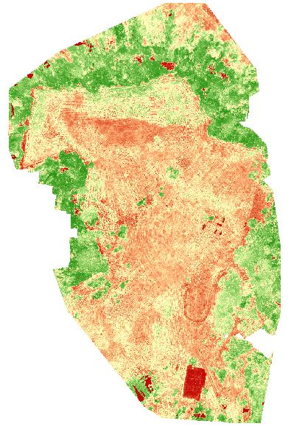
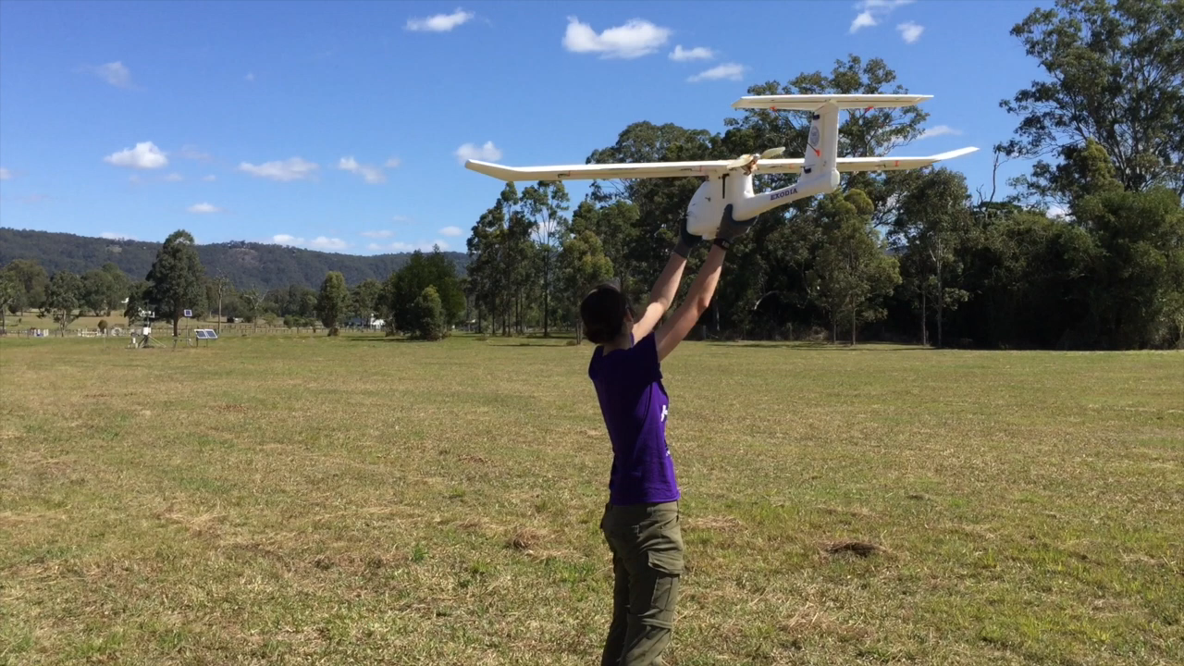
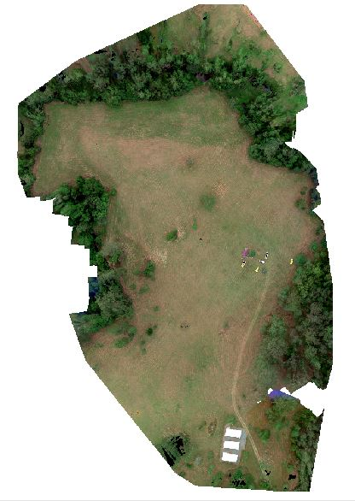
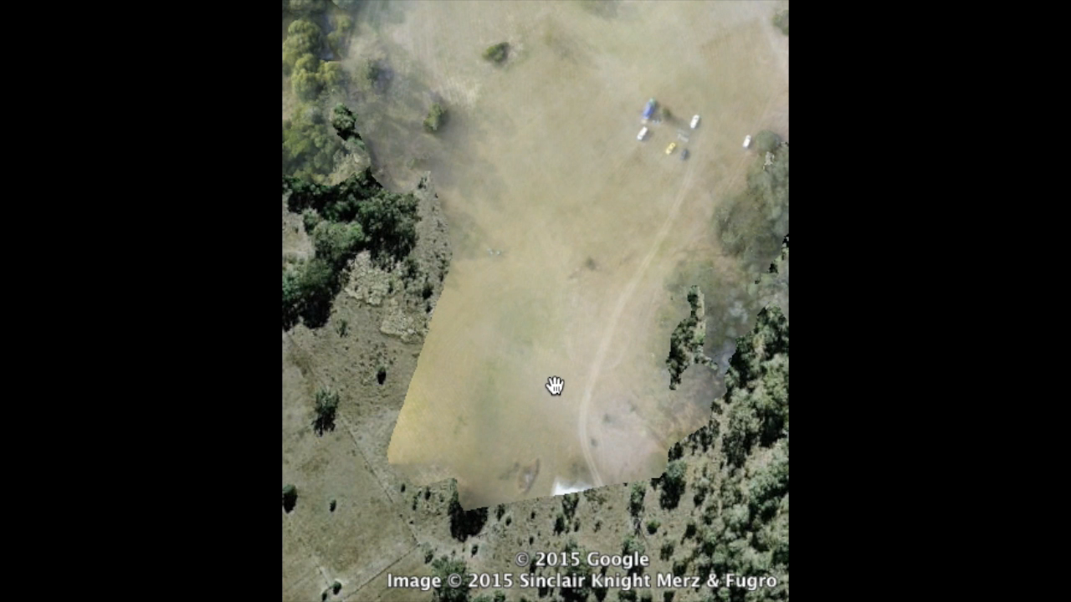
UAS for Mapping and Agriculture

Slide 5
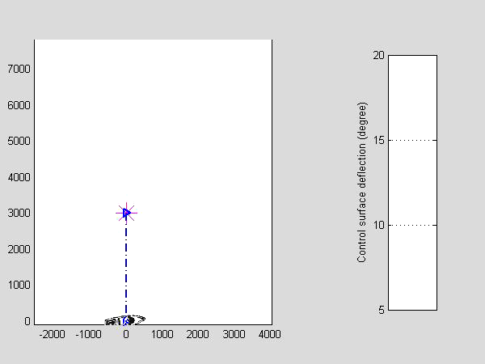
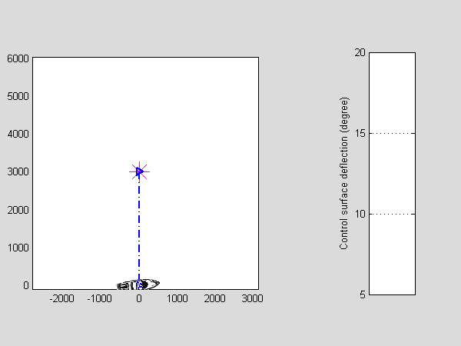
Visual Anchoring with GPS Denied

Slide 6
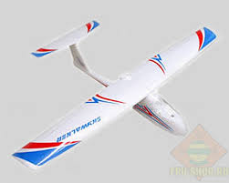

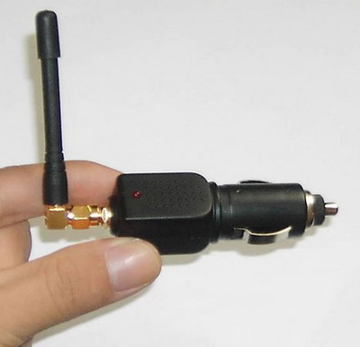
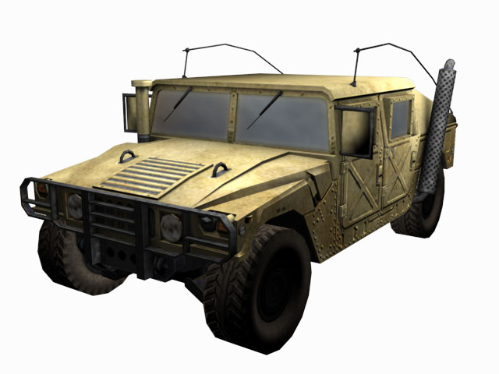
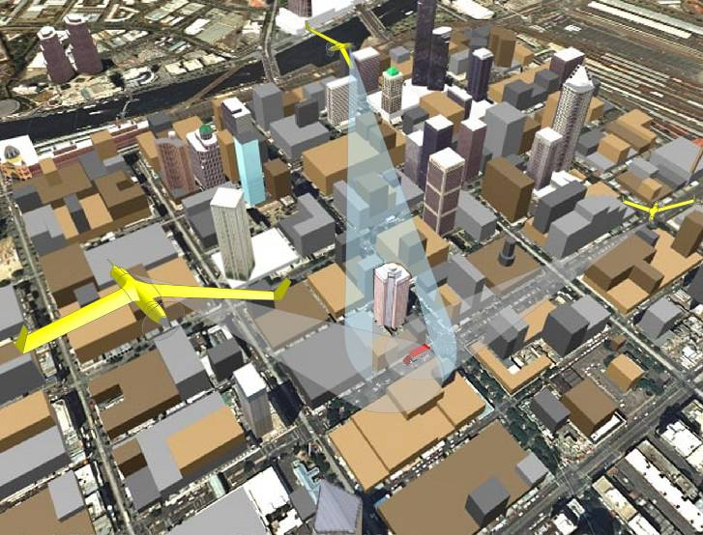
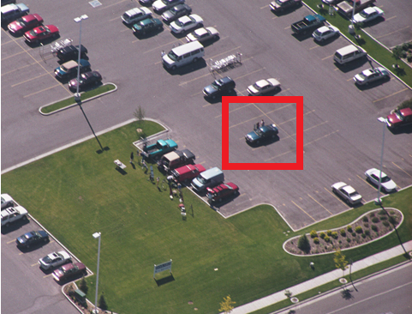
Visual Anchoring with GPS Denied
Pan/tilt/zoom camera
(ψ_{c}, θ_{c}, λ_{c})
Ground Station

Slide 7
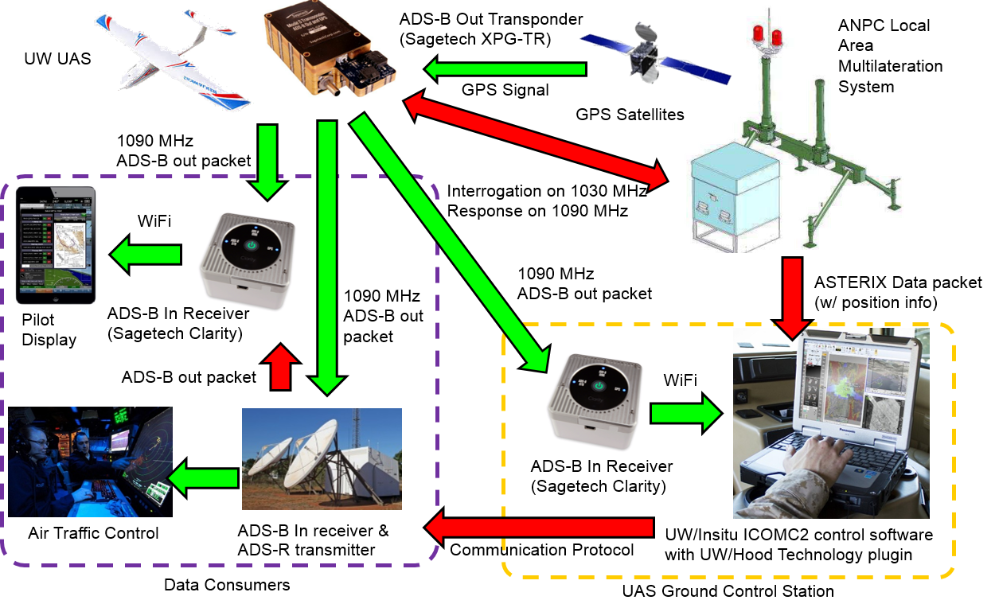
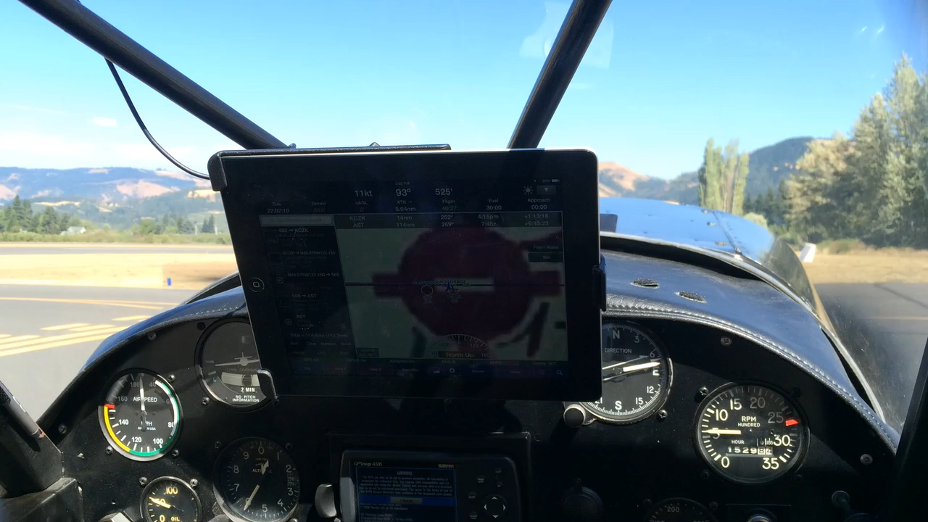
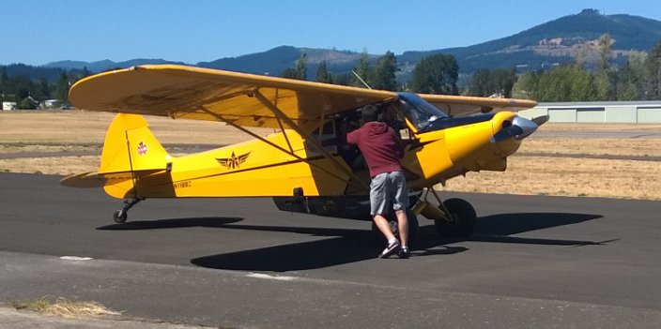
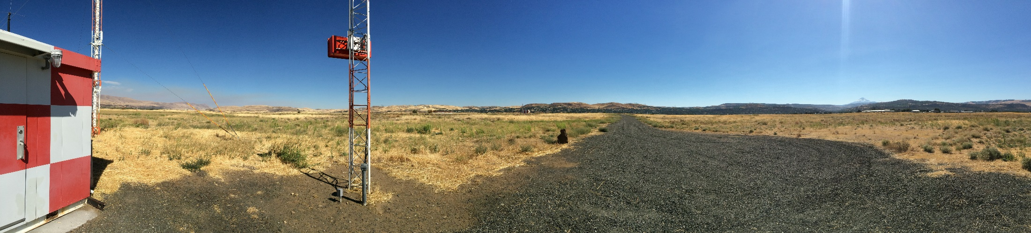
ADS-B in GPS Denied Environments

Slide 8
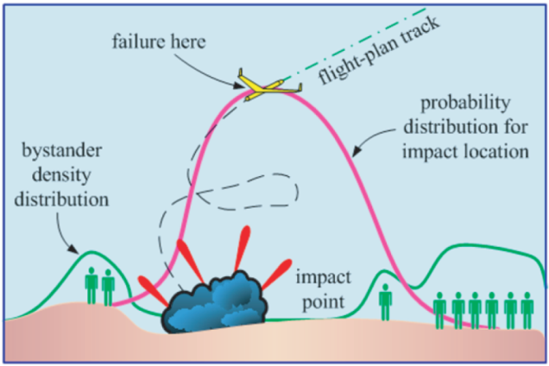
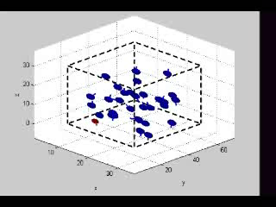
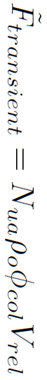
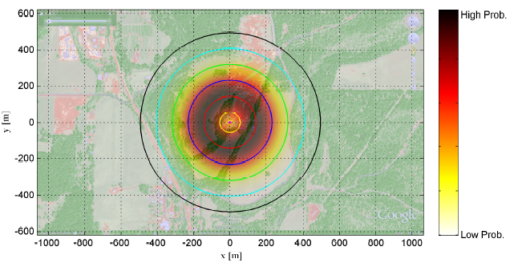
Risk Assessment of UAS Missions
Estimate risk of a given UAS mission to human life.
Various factors: midair collision, system failures, ground strikes, etc.
Parameter | Land Areas | Marine Areas
F_{transient} | 1 every 700 missions | 1 every 1300 missions
F_{ped} | 1 every 1.3 missions | 1 every 1700 missions
F_{bldg} | 1 every 0.01 missions | 1 every 420 missions
F_{fat} | 1 every 0.4 missions | 1 every 9 missions
M | $25M per mission | $1M per mission
Risk Assessment of 4 BATs Patrolling Seattle Area
C.W. Lum, K. R. Gauksheim, C. Deseure, J. Vagners, and T. McGeer, “Assessing and Estimating Risk of Operating Unmanned Aerial Systems in Populated Areas” Proceedings of the AIAA ATIO Conference, Sept. 2011
C.W. Lum, and B. Waggoner “A Risk Based Paradigm and Model for Unmanned Aerial Systems in the National Airspace” Proceedings of the AIAA Infotech@Aerospace Conference, March 2011.
Notes:
Talk about how this is a joint effort between UW and Boeing.
Outline some of the roles that each organization plays.
Talk about how this partnership has been used in the past to develop and test other algorithms and ideas in the VSTL.

Slide 9




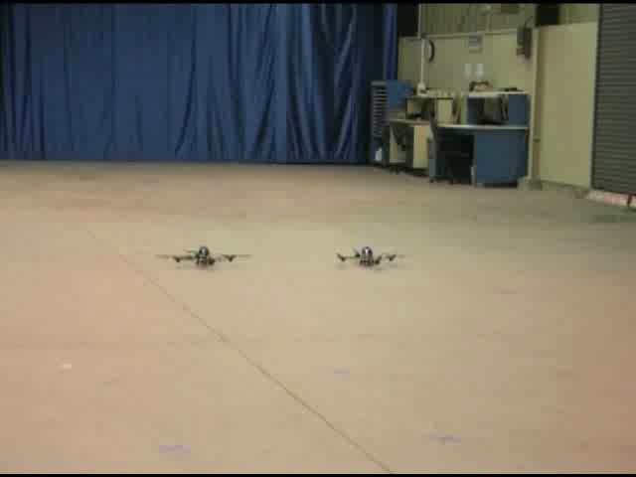
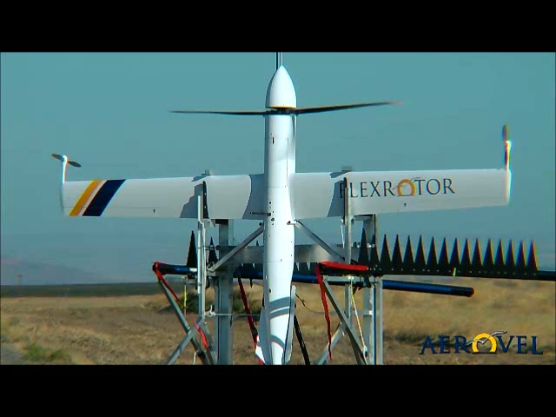
Implementation & Industry Partners
Partner w/ industry to implement academic ideas on actual systems.
Partnered with Insitu to add advance autonomy to deployed UAS
Flight test footage from Boeing VSTL search mission
Joint Research with Aerovel for acrobatic flight and risk assessment
C.W. Lum, J. Vagners, M. Vavrina, and J. Vian, “Formation Flight of Swarms of Autonomous Vehicles In Obstructed Environments Using Vector Field Navigation” Proceedings of the ICUAS Conference, June 2012
C. W. Lum, J. Vagners, J. Jang, and J. Vian, “Partitioned Searching and Deconfliction: Analysis and Flight Tests” Proceedings of the AACC American Control Conference, July 2010.
C. W. Lum, M. L. Rowland, and R. T. Rysdyk, “Human-in-the-Loop Distributed Simulation and Validation of Strategic Autonomous Algorithms” Proceedings AIAA AMTGT Conference, June 2008.
Notes:
Talk about how this is a joint effort between UW and Boeing.
Outline some of the roles that each organization plays.
Talk about how this partnership has been used in the past to develop and test other algorithms and ideas in the VSTL.

Slide 10
Select References
Path and Task Planning
C. W. Lum and R. T. Rysdyk, "Time Constrained Randomized Path Planning Using Spatial Networks" Proceedings of the AACC American Control Conference, June 2008.
J. M. Colito “Autonomous Mission Planning and Execution for Unmanned Surface Vehicles in Compliance with the Marine Rules of the Road” Masters Thesis, University of Washington, Jun 2007.
A. Pongpunwattana and R. Rysdyk, “Evolution-Based Dynamic Path Planning for Autonomous Vehicles” Innovation in Intelligent Machines, Studies in Computational Intelligence Series, Vol. 70, Springer-Verlag Berlin, pp. 113-145, 2007.
A. Pongpunwattana, R. T. Rysdyk, “Real-Time Planning for Multiple Autonomous Vehicles in Dynamic Uncertain Environments,” Journal of Aerospace Computing, Information, and Communication, Vol. 1, Dec. 2006, pp. 580-604.
D. Jia, and J. Vagners, “Parallel Evolutionary Algorithms for UAV Path Planning,” Proceedings of the AIAA 1st Intelligent Systems Technical Conference, Sept. 2004.
Multi-Agent Search
C. W. Lum, R. T. Rysdyk, and J. Vagners, "A Search Algorithm for Teams of Heterogeneous Agents with Coverage Guarantees" AIAA Journal of Aerospace Computing, Information, and Communication, Volume 7, pg. 1-31
C. W. Lum and J. Vagners, "A Modular Algorithm for Exhaustive Map Searching Using Occupancy Based Maps" Proceedings of the AIAA Infotech@Aerospace Conference, April 2009
C. W. Lum, R. T. Rysdyk, and A. Pongpunwattana, "Occupancy Based Map Searching Using Heterogeneous Teams of Autonomous Vehicles" Proceedings of the AIAA Guidance, Navigation, and Control Conference, August 2006
C. W. Lum, R. T. Rysdyk, and A. Pongpunwattana, "Autonomous Airborne Geomagnetic Surveying and Target Identification" Proceedings of the AIAA Infotech@Aerospace Conference, September 2005
Formation Flight and Swarms
C. W. Lum, J. Vagners, M. Vavrina, and J. Vian, "Formation Flight of Swarms of Autonomous Vehicles in Obstructed Environments Using Vector Field Navigation" Proceedings of the International Conference on Unmanned Aircraft Systems, June 2012
Flight Testing
C. W. Lum, J. Vagners, J. Jang, and J. Vian, "Partioned Searching and Deconfliction: Analysis and Flight Tests" Proceedings of the AACC American Control Conference, July 2010
C. W. Lum, M. L. Rowland, and R. T. Rysdyk, "Human-in-the-Loop Distributed Simulation and Validation of Strategic Autonomous Algorithms" Proceedings of the AIAA Aerodynamic Measurement Technology and Ground Testing Conference, June 2008
A. Pongpunwattana, R. Wise, R. Rysdyk, and A. Kang “Multi-Vehicle Cooperative Control Flight Test,” Proceedings of the AIAA Digital Avionics Systems Conference, October 2006.
Automatic Target Recognition/Tracking
C. W. Lum and R. T. Rysdyk, "Feature Extraction of Low Dimensional Sensor Returns for Autonomous Target Identification" Proceedings of the AIAA Guidance, Navigation, and Control Conference, August 2008
A. Pongpunwattana, B. I. Triplett, and K. A. Morgansen, “Target Tracking Control with Limited Communication and Steering Dynamics” IEEE/RSJ International Conference on Intelligent Robots and Systems, November, 2007.
Risk Assessment of UAS
C.W. Lum, K. R. Gauksheim, C. Deseure, J. Vagners, and T. McGeer, “Assessing and Estimating Risk of Operating Unmanned Aerial Systems in Populated Areas” Proceedings of the AIAA ATIO Conference, Sept. 2011
C.W. Lum, and B. Waggoner “A Risk Based Paradigm and Model for Unmanned Aerial Systems in the National Airspace” Proceedings of the AIAA Infotech@Aerospace Conference, March 2011.
Notes:
Talk about how this is a joint effort between UW and Boeing.
Outline some of the roles that each organization plays.
Talk about how this partnership has been used in the past to develop and test other algorithms and ideas in the VSTL.

